Slide 1

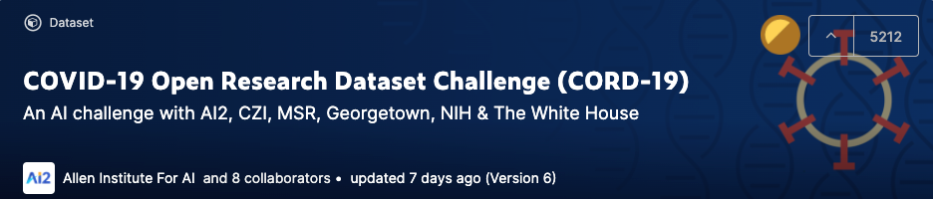

COVID-19 Challenge
Research
Project
Discussion Deck

Slide 2

Objective & Agenda
Objective
Is there a go-forward project we can / want to pursue?
If so, determine plan & next steps
Agenda
Introductions
Review Deadlines / Discuss Rules
Select Task / Subtasks
Explore approach including problem statement / hypothesis
Discuss roles, next steps, additional resources required

Slide 3
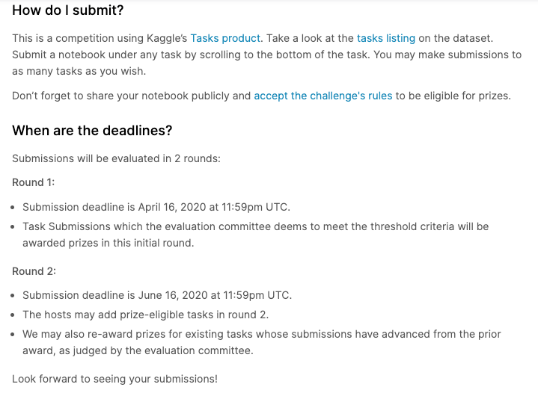
Deadlines
https://www.kaggle.com/allen-institute-for-ai/CORD-19-research-challenge/discussion/135826

Slide 4
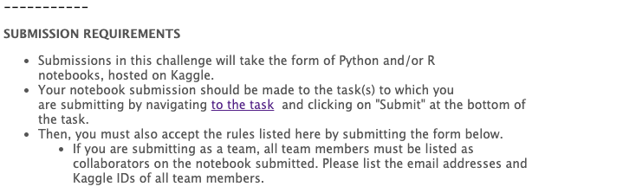
Submission Requirements
https://www.kaggle.com/cord-19-rules-accept-form

Slide 5
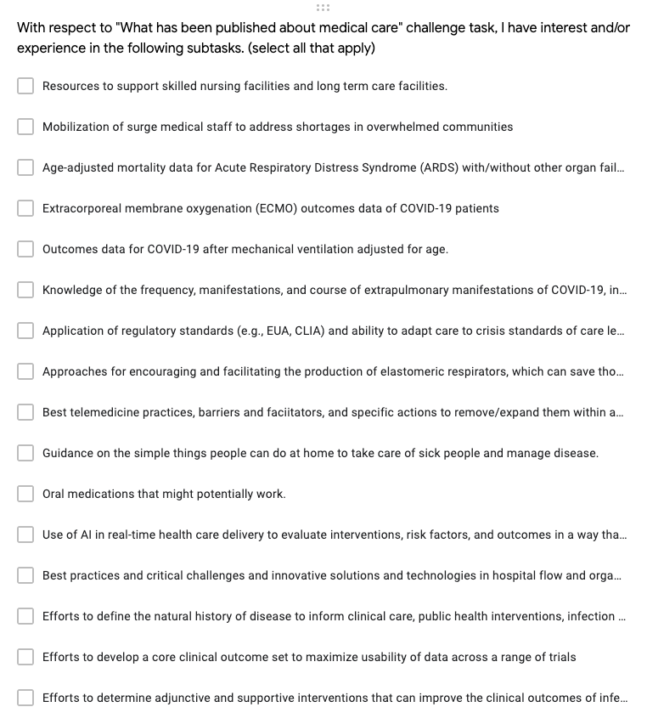
Subtasks: What has been published about medical care?
X
X
X
3 votes
2 votes
X
X
https://www.kaggle.com/allen-institute-for-ai/CORD-19-research-challenge/tasks?taskId=572

Slide 6
Questions
What do we learn from existing submissions?
Is there a subtask we want to pursue?
Problem statement / hypothesis?
Approach?

Slide 7
Next Steps
Next Step | Owner | Date | Add’l Resources Needed

Slide 8


